Slide 1
Manycore Network Interfaces for In-Memory Rack-Scale Computing
Alexandros Daglis, Stanko Novakovic,
Edouard Bugnion, Babak Falsafi, Boris Grot

Slide 2
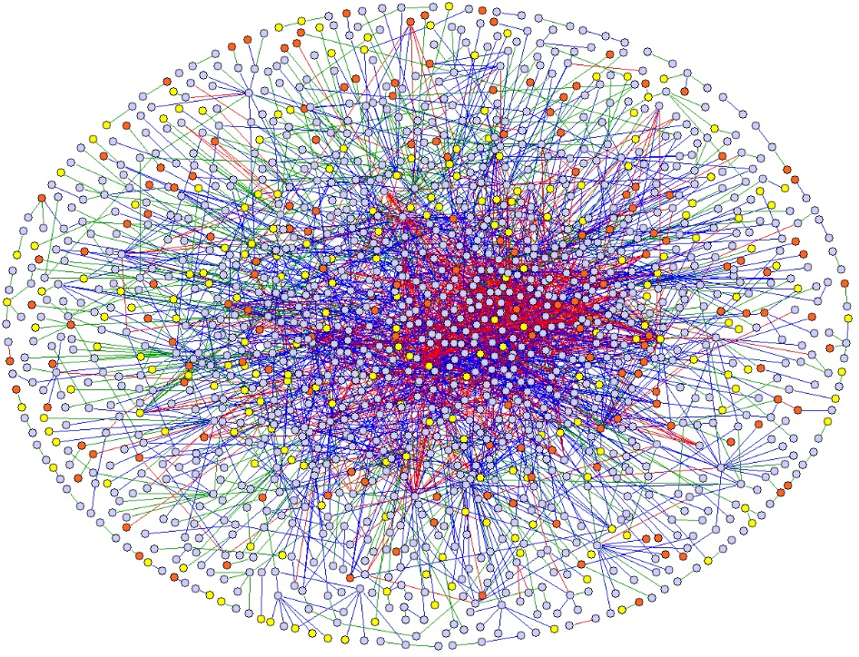
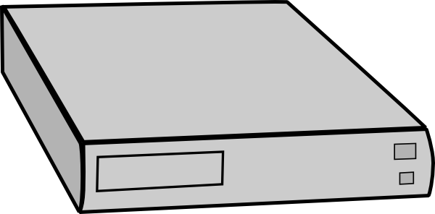
In-Memory Computing for High Performance
Tight latency constraints → Keep data in memory
Data
Need large memory pool to accommodate all data

Slide 3
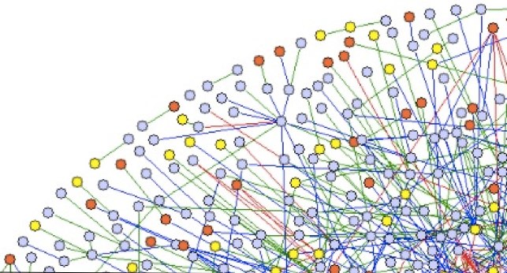
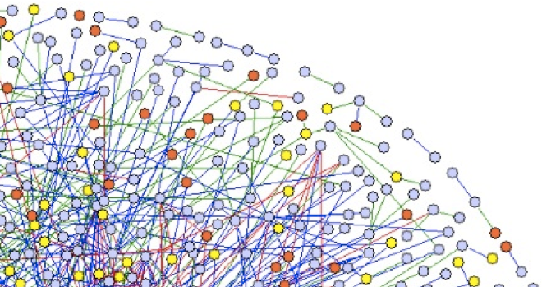
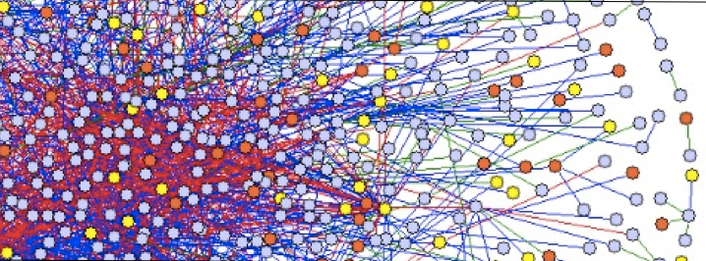
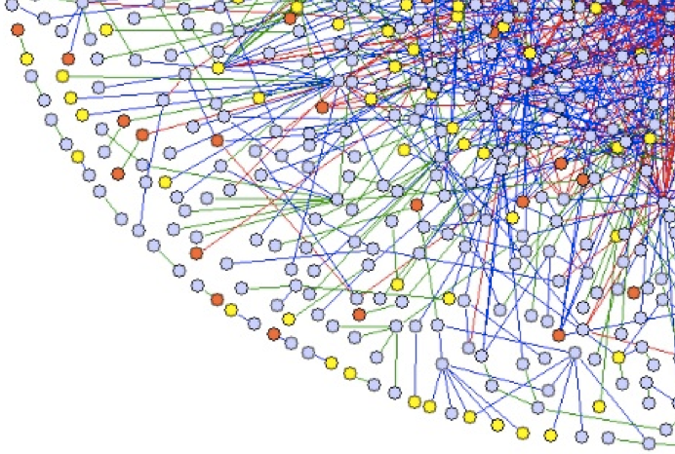
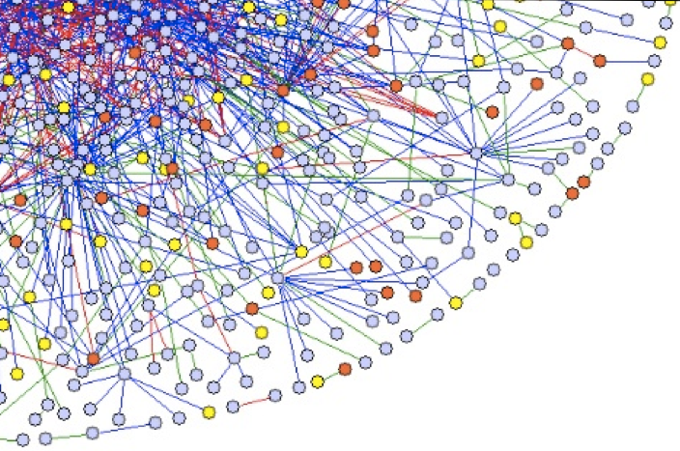
Nodes Frequently Access Remote Memory
Graph Serving
Fine-grained access
Graph Analytics
Bulk access
Need fast access to both small and large objects in remote memory

Slide 4
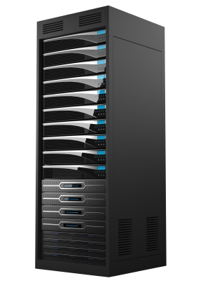
Rack-Scale Systems: Fast Access to Big Memory
Vast memory pool in small form factor
On-chip integrated, cache-coherent NIs
Examples: QPI, Scale-Out NUMA [Novakovic et al., ‘14]
High-performance inter-node interconnect
NUMA environment
Low latency for fine-grained transfers
High bandwidth for bulk transfers
Large memory capacity, low latency, high bandwidth

Slide 5
Remote Memory Access in Rack-Scale Systems
Integrated NIs
Interaction with cores via memory-mapped queues
Directly access memory hierarchy to transfer data
c
c
c
c
c
c
c
c
c
c
c
c
c
c
c
c
c
c
c
c
c
c
c
c
c
c
c
c
c
c
Network
c
c
c
c
c
c
c
c
c
c
c
c
NI
c
c
c
c
c
c
NI
NI
NI
c
c
c
c
c
c
c
c
c
c
c
c
c
c
c
c
c
c
c
c
c
c
c
c
Interaction with cores
: Latency-critical
Data transfer
: Bandwidth-critical

Slide 6
Network Interface Design for Manycore Chips
NI placement & design is key for remote access performance
Obvious NI designs suffer from poor latency or bandwidth
Contributions
NI design space exploration for manycore chips
Seamless integration of NI into chip’s coherence domain
Novel Split NI design, optimizing for both latency and bandwidth
This talk: Low-latency, high-bandwidth NI design for manycore chips

Slide 7
Outline
Overview
Background
NI Design Space for Manycore Chips
Methodology & Results
Conclusion

Slide 8
User-level Remote Memory Access
RDMA-like Queue-Pair (QP) model
Cores and NIs communicate through cacheable memory-mapped queues
Work Queue (WQ) and Completion Queue (CQ)
Local node
Remote node
write
WQ
poll
Direct memory
access
Inter-node
network
core
NI
NI
poll
CQ
write
soNUMA: Remote memory access latency ≈ 4x of local access

Slide 9
Implications of Manycore Chips on Remote Access
NI capabilities have to match chip’s communication demands
More cores → Higher request rate
Straightforward approach: scale NI across edge
Close to network pins
Access to NOC’s full bisection bandwidth
Caveat: Large average core to NI distance
c
c
c
c
c
c
c
c
c
c
c
c
c
c
c
c
c
c
c
c
c
c
c
c
c
c
c
c
c
c
c
c
c
c
c
c
Significant impact of on-chip interactions on end-to-end latency

Slide 10
Edge NI 4-Cache-Block Remote Read
Incoming replies
Outgoing requests
QP interactions
$
Core writes WQ
NI writes CQ
Core reads CQ
NI reads WQ
$
dir
LLC
Network Router
core
NOC router
QP
dir
Bandwidth ✓
Latency ✗
Data handling
NI unrolls to cache-block-sized requests
Data transfer completed. Repeat QP interactions to write CQ
QP interactions account for up to 50% of end-to-end latency

Slide 11
NI Design Space
Edge NI
Target
Bandwidth
Latency

Slide 12
Reducing the Latency of QP Interactions
Collocate NI logic per core, to localize all interactions
Still have coherence directory indirection ☹
core
$
$
QP
dir

Slide 13
Reducing the Latency of QP Interactions
Collocate NI logic per core, to localize all interactions
Still have coherence directory indirection ☹
Attach NI cache at core’s L1 back side
Similar to a write-back buffer
Transparent to coherence mechanism
No modifications to core’s IP block
core
$
$
☺
Localized QP interactions: latency of multiple NOC traversals avoided!

Slide 14
Per-Core NI 4-Cache-Block Remote Read
Outgoing requests
All QP interactions local!
Network Router
Data handling

Slide 15
Per-Core NI 4-Cache-Block Remote Read
Incoming replies
Write payload in LLC
Network Router
Data handling
All reply packets received!
Write CQ locally
Bandwidth ✗
Latency ✓
Minimized latency but bandwidth misuse for large requests

Slide 16
NI Design Space
Edge NI
Target
Bandwidth
Per-core NI
Latency

Slide 17
How to Have Your Cake and Eat It Too
Insight:
QP interactions best handled at request’s initiation location
Data handling best handled at the chip’s edge
Solution: The two can be decoupled and physically separated!
NI Frontend
NI Backend
Communication
via NOC packets
QP interactions
QP interactions
Data handling
Network packet handling
Data handling
Network packet handling
Split NI addresses the shortcomings of Edge NI and Per-core NI

Slide 18
Split NI 4-Cache-Block Remote Read
Incoming replies
Outgoing requests
All QP interactions local!
Network Router
Data handling
All reply packets received!
Write CQ locally
Bandwidth ✓
Latency ✓
Both low-latency small transfers and high-bandwidth large transfers

Slide 19
NI Design Space
Split NI
Edge NI
Target
Bandwidth
Per-core NI
Latency

Slide 20
Methodology
Case study with Scale-Out NUMA [Novakovic et al., ‘14]
State-of-the-art rack-scale architecture based on a QP model
Cycle-accurate simulation with Flexus
Simulated single tiled 64-core chip, remote ends emulated
Shared block-interleaved NUCA LLC w/ distributed directory
Mesh-based on-chip interconnect
DRAM latency: 50ns
Remote Read microbenchmarks
Data exceeds LLC capacity

Slide 21
Application Bandwidth
Peak available bandwidth (256GBps)
Split NI: Maximized useful utilization of NOC bandwidth

Slide 22
Latency Results for Single Network Hop
Network roundtrip latency (70ns)
Split NI: Remote memory access latency within 13% of ideal

Slide 23
Conclusion
NI design for manycore chips crucial to remote memory access
Fast core-NI interaction critical to achieve low latency
Large transfers best handled at the edge, even in NUMA machines
Per-Core NI: minimized cost of core-NI interaction
Seamless core-NI collocation, transparent to chip’s coherence
Split NI: low-latency, high-bandwidth remote memory access
Non-intrusive design – No modifications to core’s IP block

Slide 24
Thank you! Questions? http://parsa.epfl.ch/sonuma

